Slide 1
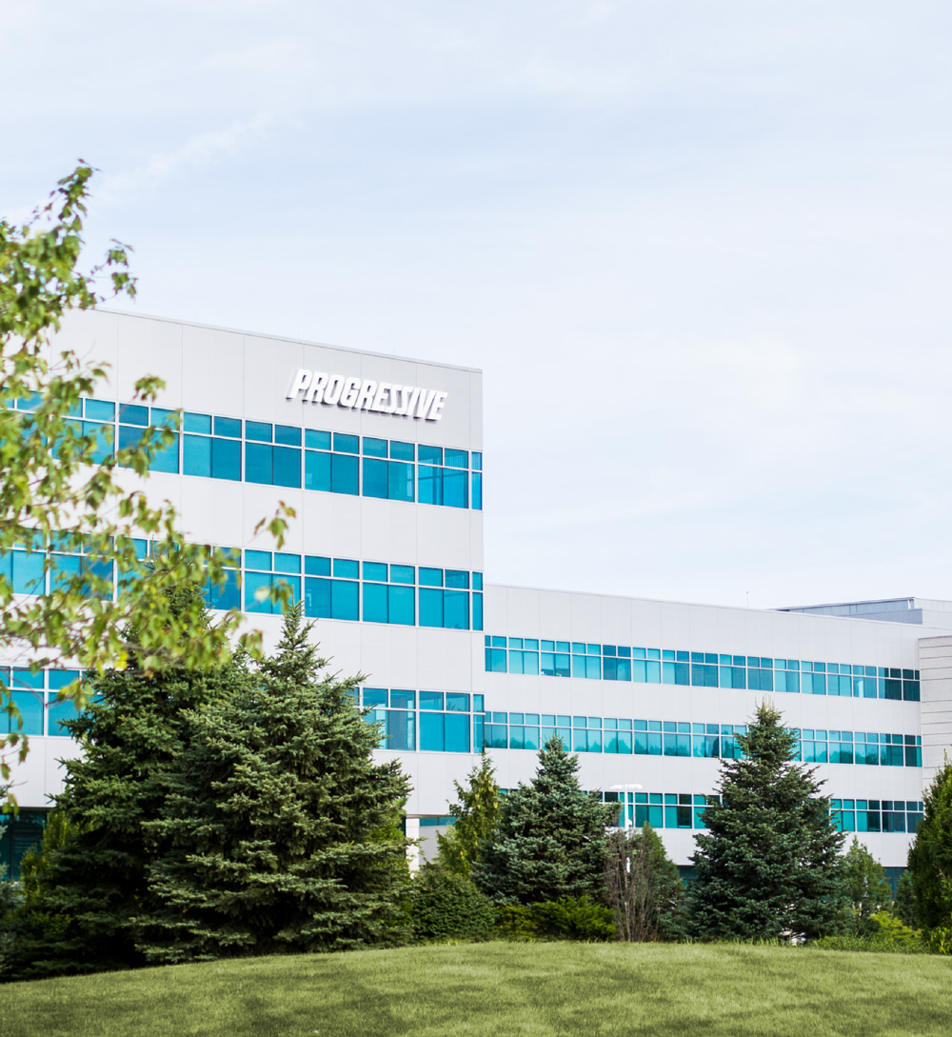

Analyst
Boot Camp Group Project
April 2025

Slide 2
Agenda
01 | Introductions
02 | Project Goals
03 | Project Background & Data
04 | Project Schedule
05 | Guest Speaker
06 | Closing
2

Slide 3
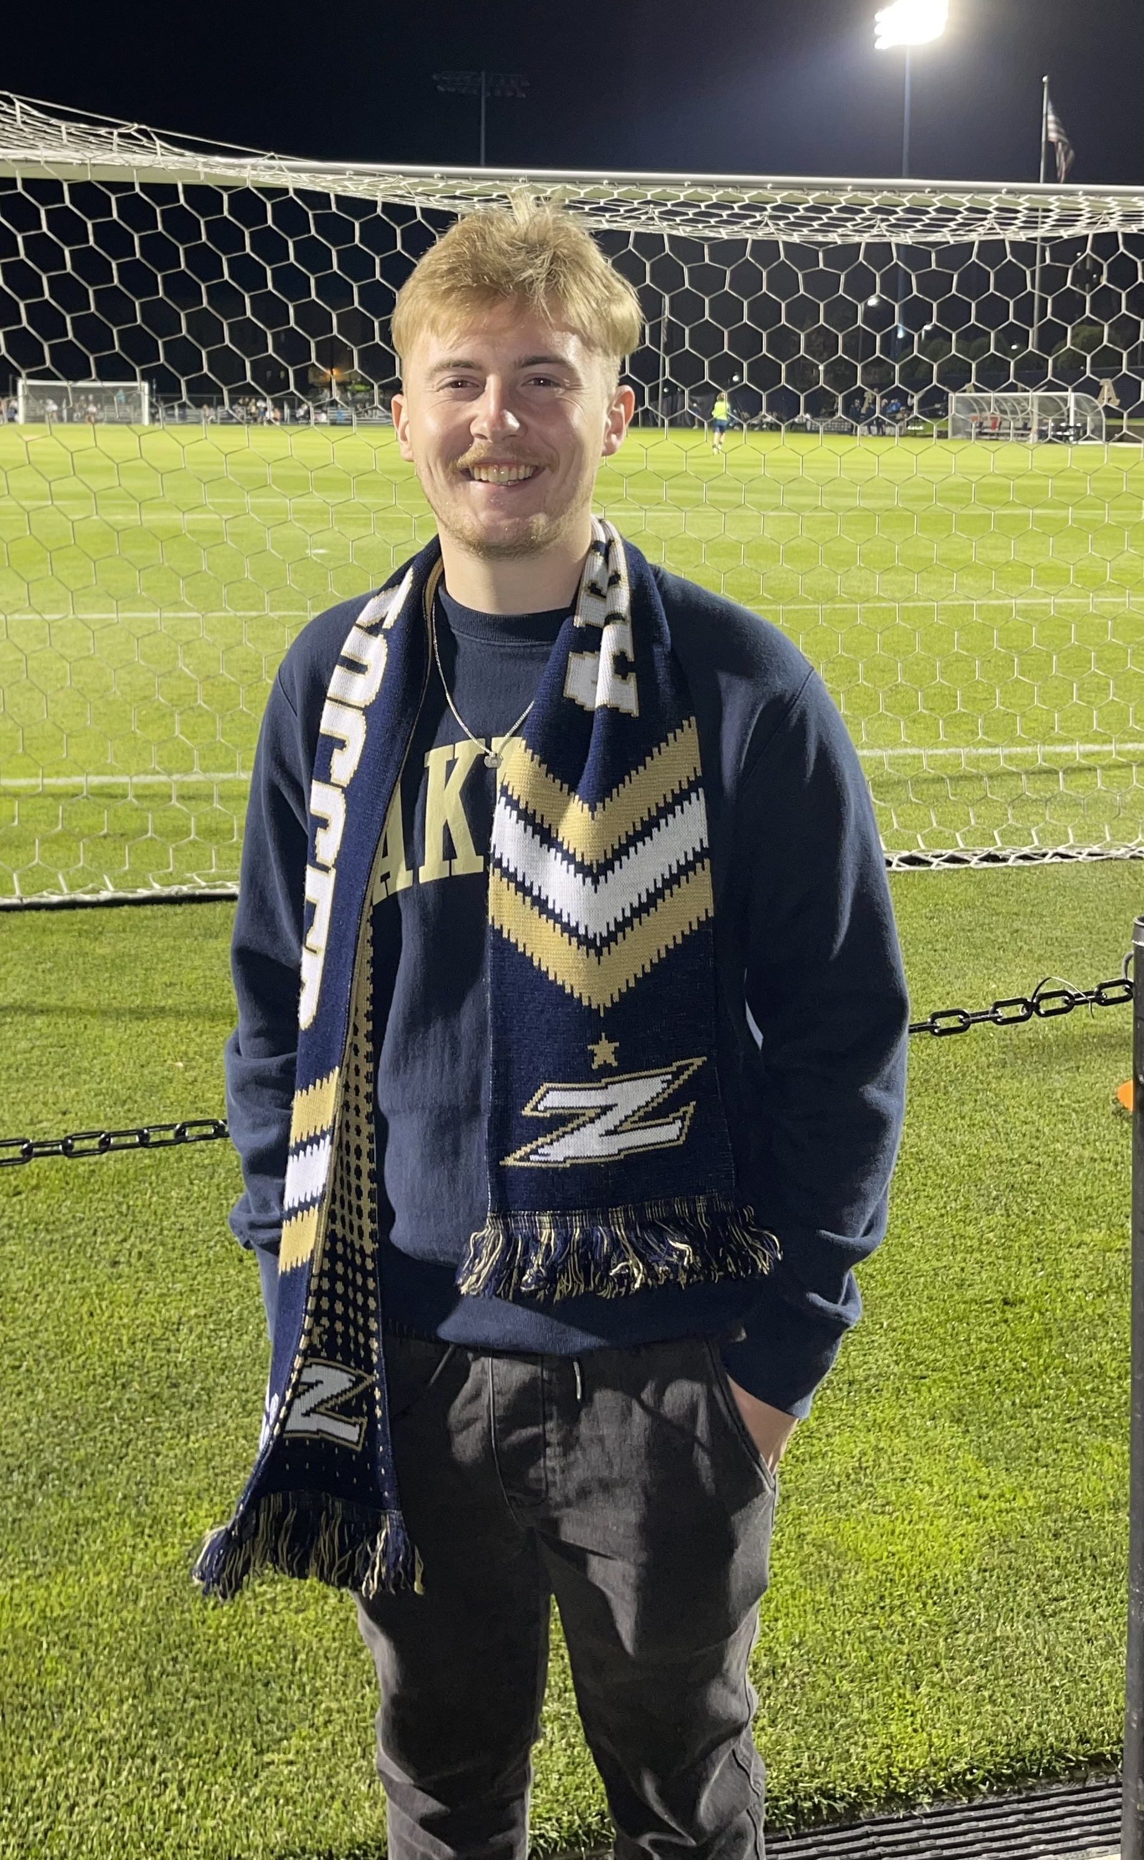

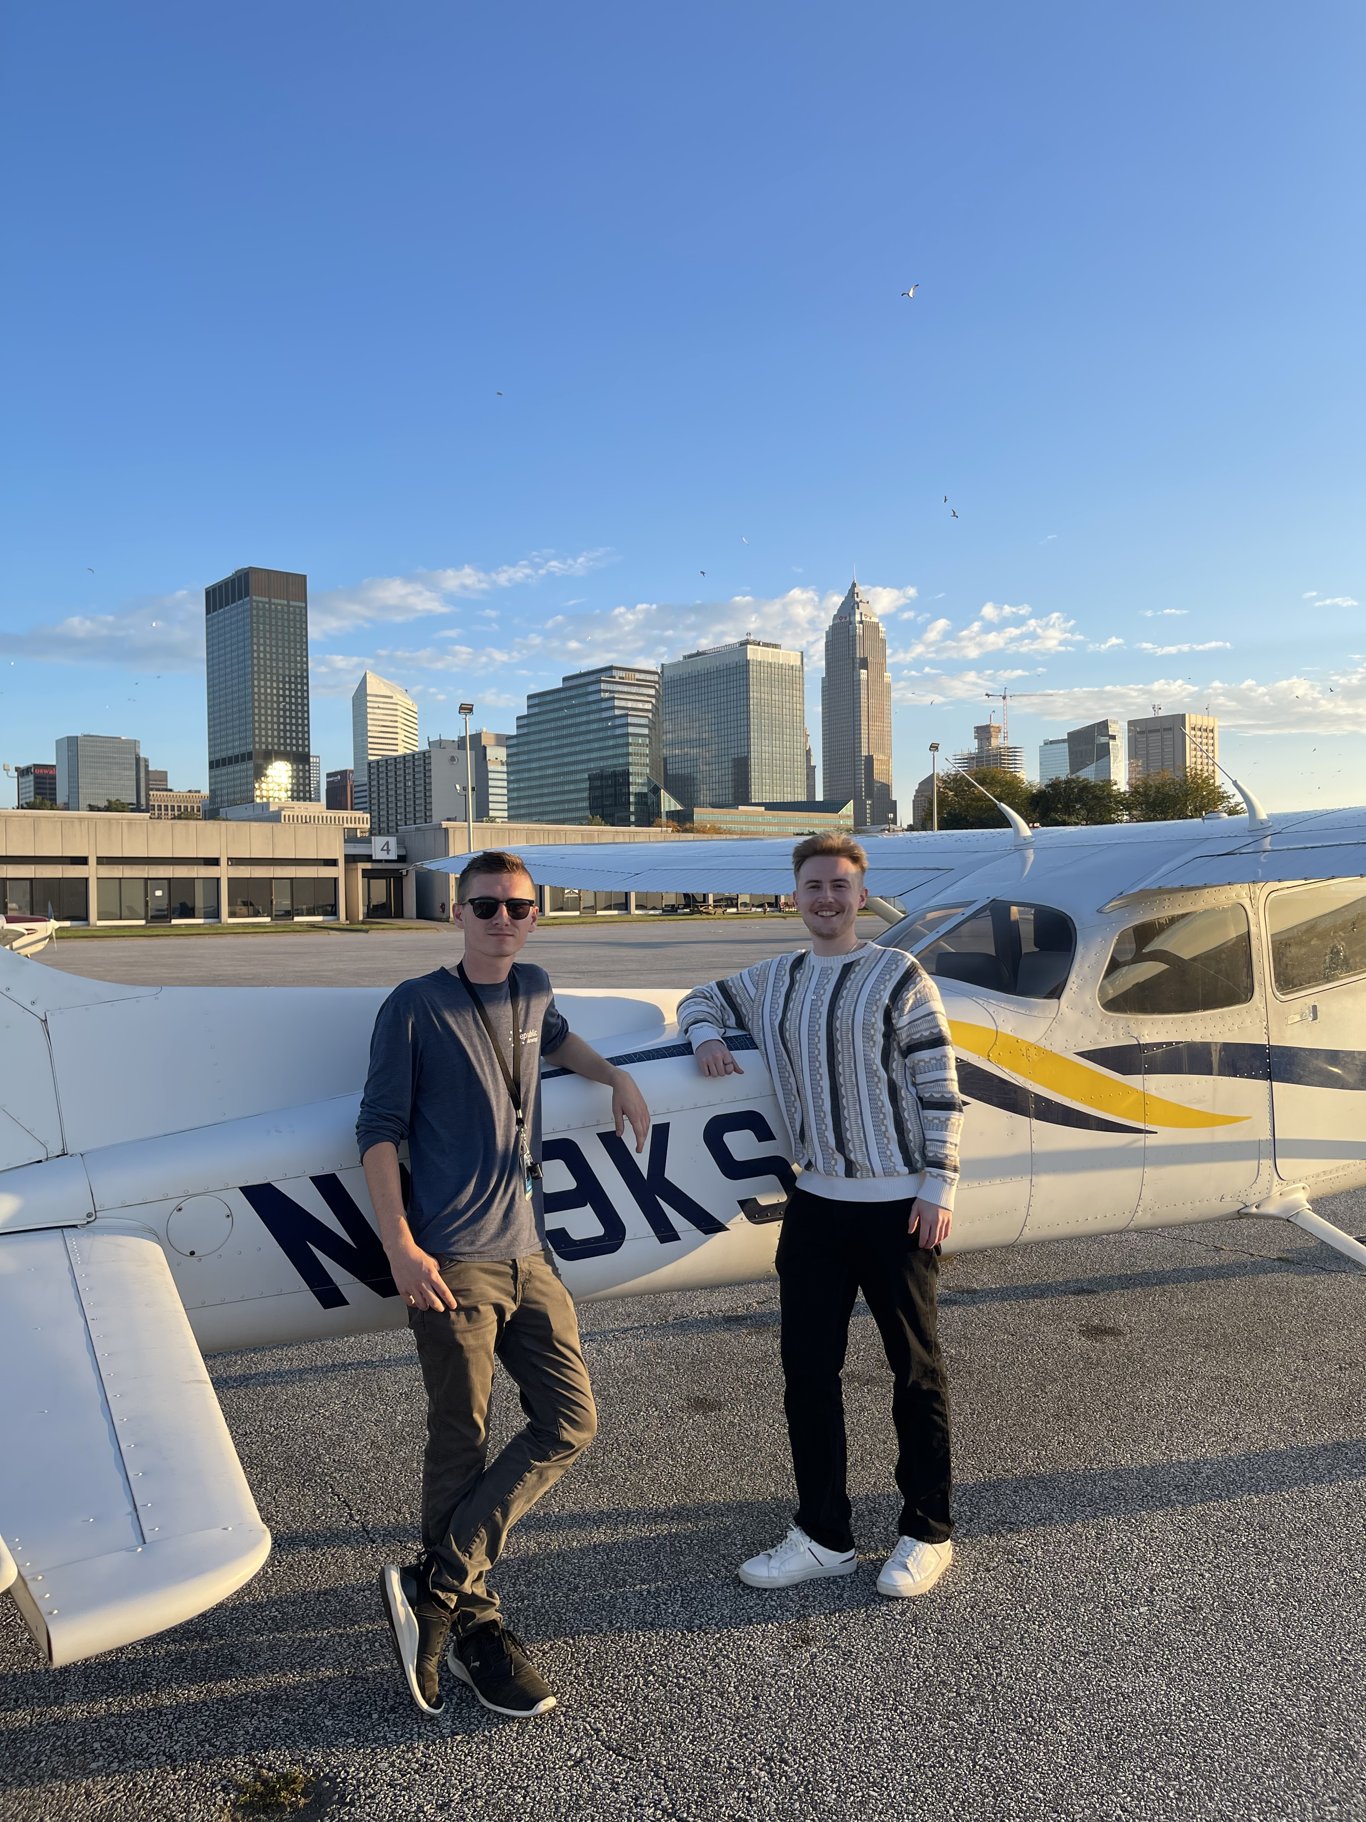
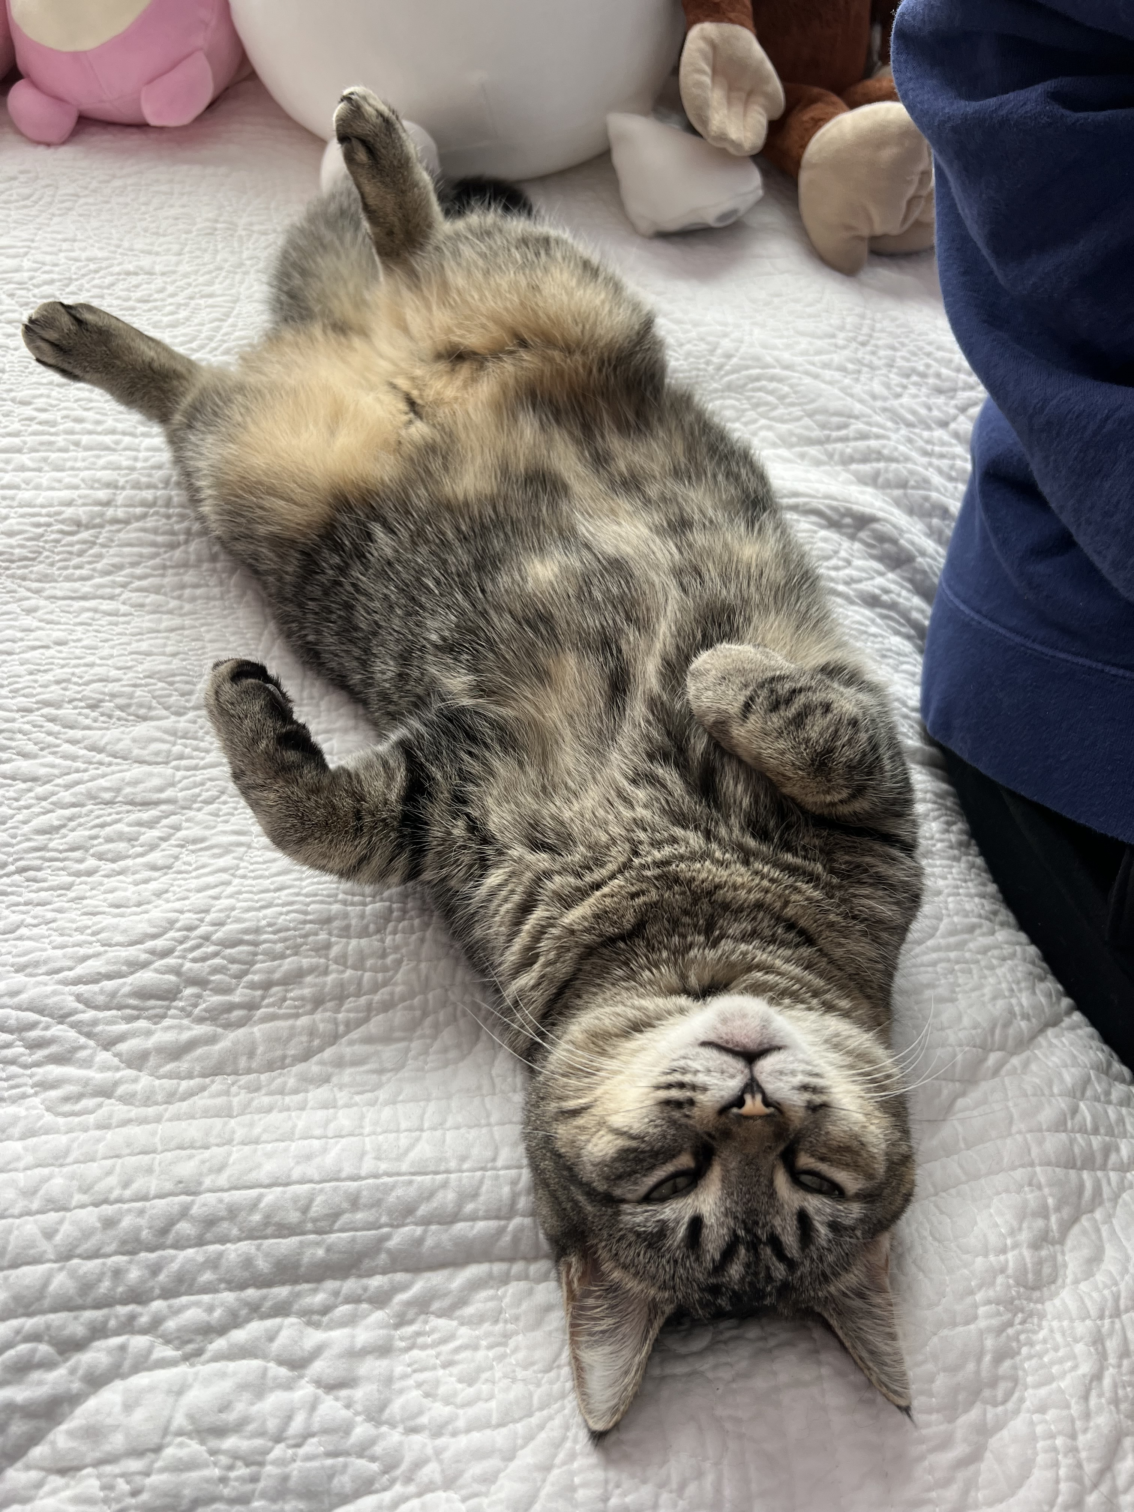


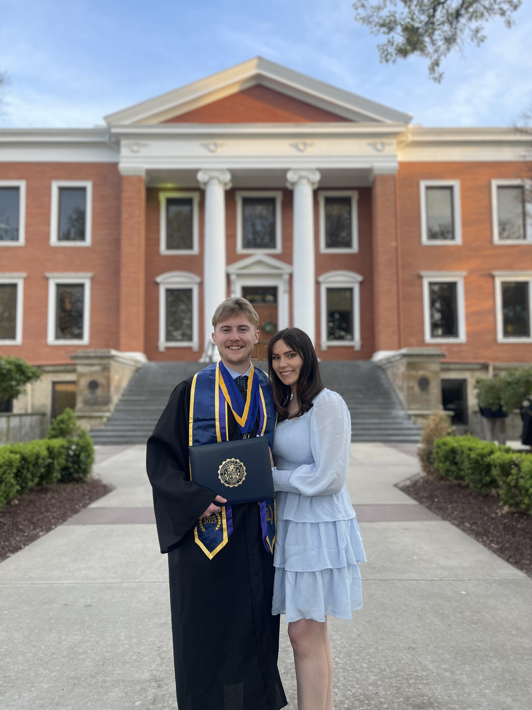
Xavier Zup
Data Analyst II, Personal Lines Control

Slide 4

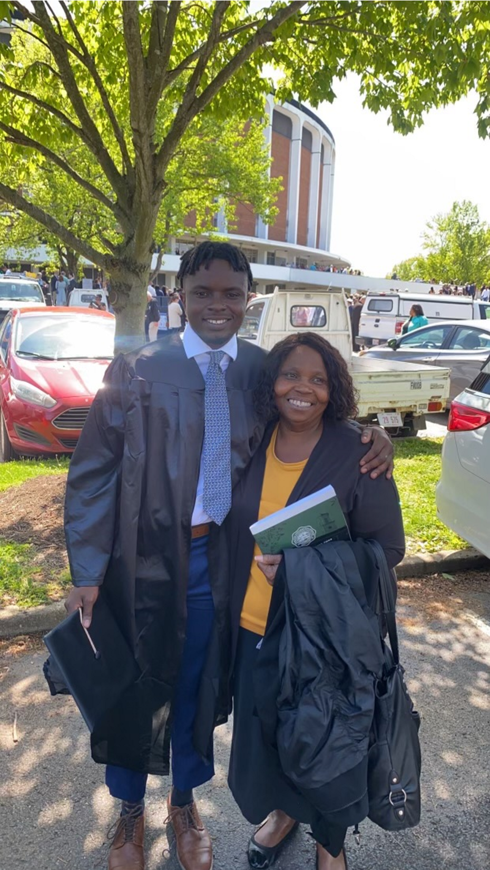
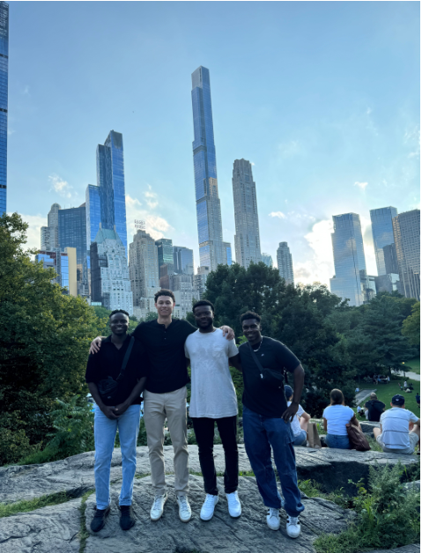



Austin Cade
Pricing Analyst II, Commercial Lines

Slide 5

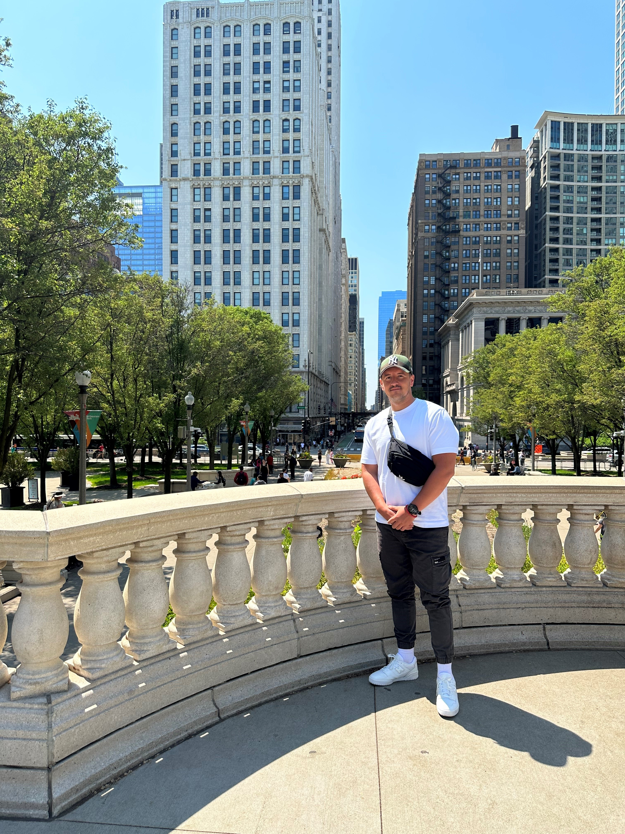
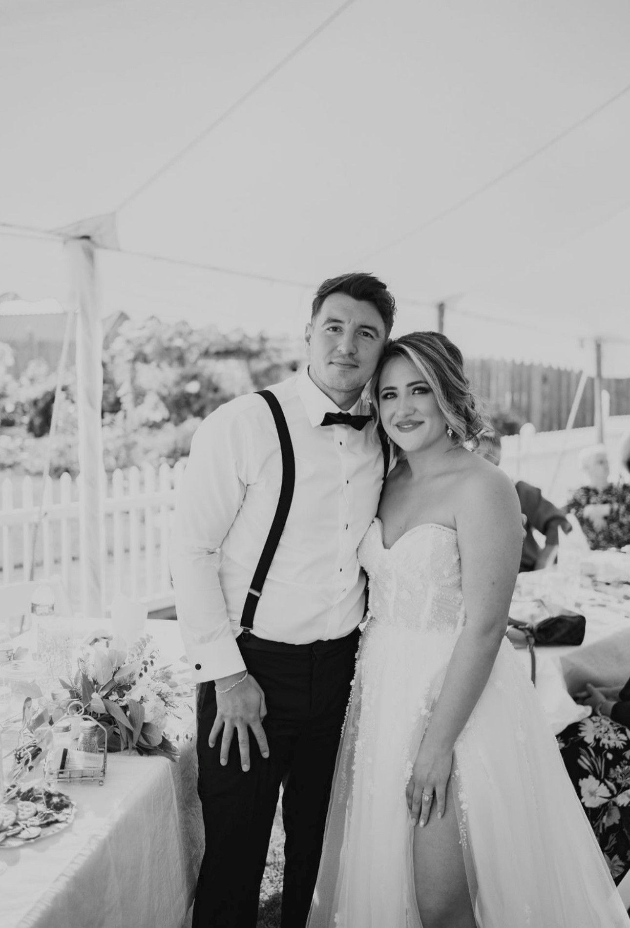




Anes Sljivo
ADP Rotational Analyst, Commercial Lines. 2nd place InVIZtational, 2024

Slide 6


Section
02
The greater danger for most of us lies not in setting our aim too high and falling short, but in setting our aim too low and achieving our mark.
Project Goals
Michelangelo
Italian Renaissance Artist
6

Slide 7
Project Goals
1.
2.
3.
Business Strategy
Engages in comprehensive discussions with various stakeholders to understand and translate business needs into actionable strategies, ensuring alignment with management objective.
Technical Skills
Employs advanced technical expertise in developing analytical programs using tools like SAS and SQL, alongside proficient data retrieval, verification, and presentation techniques to support complex business analysis requirements.
Analytical Creativity
Leverages analytical creativity to compile, forecast, and interpret data trends, recommending innovative solutions and process improvements to stakeholders, and leading complex projects beyond one's own business area.
7

Slide 8
Look Familiar?
These Goals Align with Data Analyst III Roles
Click here -> Job Profile
Search “Data Analyst”
8

Slide 9
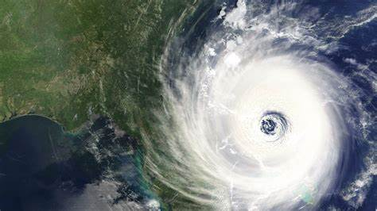
Section
03
Project Background and Data
9

Slide 10





Start Your Engines!
Project
Background
These datasets revolves around Hurricanes
Data Sets
Parameters
InVIZtational
Hurricane Data
Progressive Claims Data
You will have 2 weeks to use any Progressive-approved tools of your choice to build a visualization, which will be judged on analysis, design, and storytelling.
You are required to use the Hurricane Data, the Claims dataset is optional. Feel Free to join any other relevant data
This project is inspired from the yearly competition Progressive hosts through the Analyst Professional Group (APG)
Progressive InVIZtational (sharepoint.com)
10

Slide 11
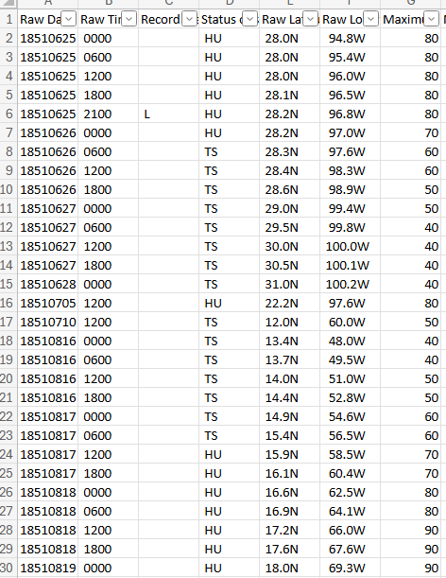

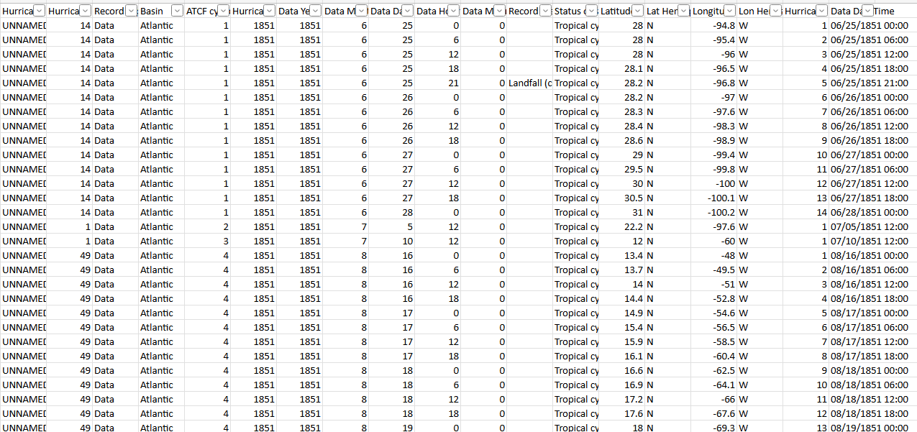
Data Set 1
Hurricane
Link:
Atlantic and Pacific Hurricane Data
Source: Source information can go here in this area
11

Slide 12
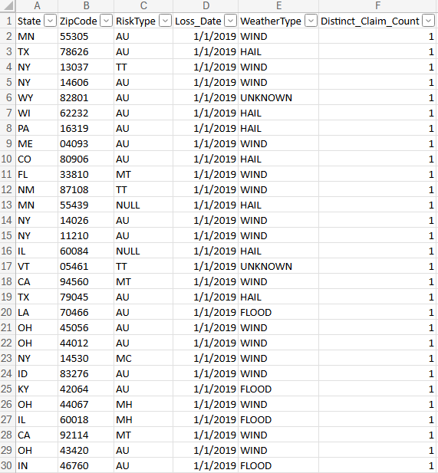
Data Set 2
Progressive Claims Data
Link:
Weather Claims
Source: Source information can go here in this area
12

Slide 13

Section
04
Project Schedule
13

Slide 14
Estimated Timeline
Day 1
Project Kick-off, Dataset Exploration, and Guest Speaker
Day 3
Data Preparation
Day 5
Visualization
and Guest Speaker
Day 7
Dashboard Creation
Day 9
Presentation
and Guest Speaker
Apr 7 | Apr 8 | Apr 9 | Apr 10 | Apr 11 | Apr 15 | Apr 15 | Apr 16 | Apr 17 | Apr 18
Day 2
Initial Analysis
and Check-in: One
Day 4
Data Preparation Continued
and Check-in: Two
Day 6
Visualization Continued
and Check-in: Three
Day 8
Dashboard Creation Continued
and Check-in: Four
Day 10
Final Presentations
with Special Judges
14

Slide 15

Section
05
Guest Speaker
Alec Wong
15

Slide 16
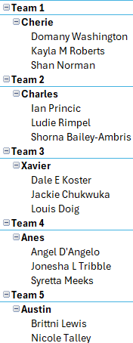
Teams

Slide 17

Thank You
17

